Slide 1
Simple Stream Recycling
A Guide

Slide 2
“Simple Stream” Recycling
All approved recyclable items go into the same container.
Janitorial staff collects the recyclables from desk-side or common room containers and places them into the designated recycling container in the outside disposal area.
Advanced Disposal collects the recycling and takes it to a processing facility.

Slide 3
What goes in the recycling bin…
Cardboard
Containerboard
Newspaper
Magazines
Office paper
Junk mail
Envelopes
File folders
Phone books
*Acceptable items vary by location. Confirm with your Advanced Disposal representative.
Plastic #’s 1-7
Water bottles
Glass (clear, green, brown)
Steel & tin cans
Aluminum
Aseptic packaging
Milk cartons
Juice boxes
Soup containers

Slide 4
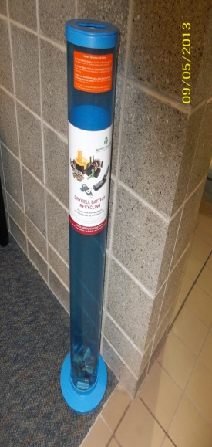
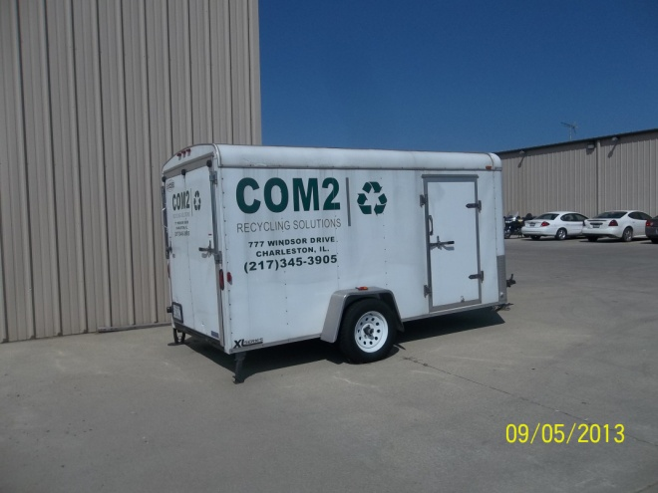
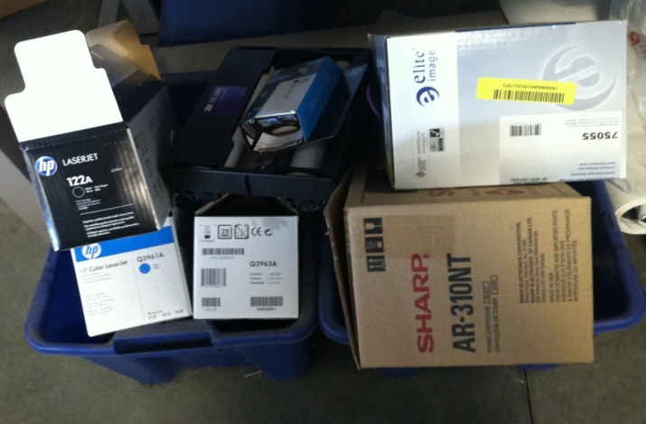
What stays out of the recycling bin…
Food waste
Restroom waste
Medical waste
Electronics
Batteries
Printer cartridges
Light bulbs
Ceramics
Heat resistant glass
Styrofoam
Polystyrene

Slide 5
Office & common room recycling containers
Indoor container size and shape are determined by customer preference.
Liners are not preferred but if used should be CLEAR.

Slide 6
Office & common area trash containers
Should look or be labeled differently than recycled containers.
Use dark GREEN OR BLACK liners.

Slide 7
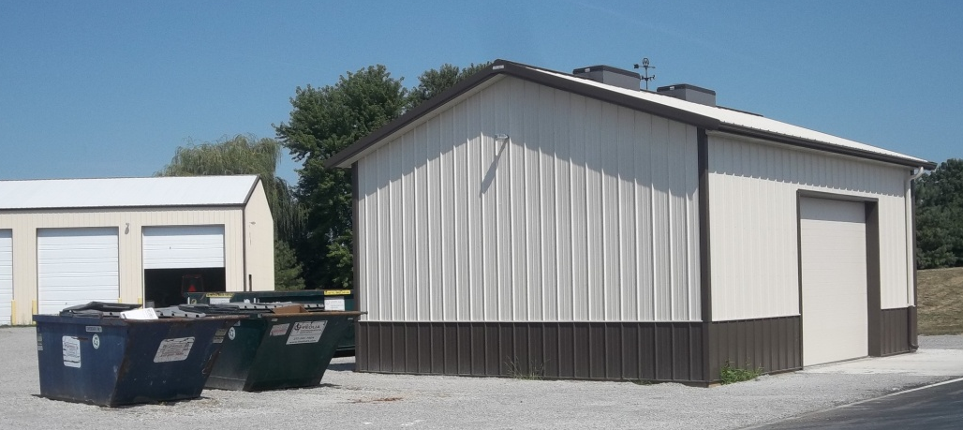
Recycling & trash collection containers
Collection containers look the same if used for recycling or trash.
Containers are labeled to indicate whether recycling or trash should be placed inside.

Slide 8
Where does the recycling go?
Advanced Disposal trucks collect the recyclables and take them to a processing facility called a material recovery facility or “MRF.”
MRF’s separate the items to create the highest value raw materials.
Raw materials are then sent to manufacturers to be made into new products.

Slide 9
Recycling is simple and smart
Plastic soda bottles are recycled into fiberfill, fleece wear, luggage, picnic tables, benches, carpet, buckets and pipe.
Forty recycled plastic soda bottles make enough fiberfill to stuff a sleeping bag.
You can save enough energy to operate a TV for 6 hours by recycling just two aluminum cans.
Aluminum cans are recycled into lawn chairs, construction products, aluminum foil and even cars.
Newspaper and other paper products are recycled into writing paper, cereal boxes, paper towel, tissue paper and cardboard.
Recycling 1 ton of paper saves 17 mature trees, 7,000 gallons of water, 3 cubic yards of landfill space, 2 barrels of oil and 4,100 kilowatt-hours of electricity – enough energy to power the average American home for 5 months.
We can easily put Mother Nature’s recycling system to work in our gardens by spreading yard waste around trees, shrubs, and other plantings. Some common mulching materials are: grass clippings, green leaves, brown leaves and wood chips

Slide 10
Leave work a little cleaner than you found it

