Slide 1
Transitional Math
Lake Land College

Slide 2
Postsecondary & Workforce Readiness Act
Postsecondary & Workforce Readiness Act, or PWR Act, was signed into law in July 2016. A major component of the law relates to transitional math courses, which are courses for seniors in high schools
ISBE and ICCB have established that every high school must have a transitional math course implemented by 21-22 school year.
The goal is to increase college readiness and reduce remediation

Slide 3
Time Frame
Documentation for 20-21 implemented courses need be turned in by February 12th. If approved this Spring, students will have guaranteed placement FA 21.
Documentation for 21-22 courses must be approved by Spring 22. You have three deadlines opportunities for submission:
  SP 21: February 12th
  SU 21: May 7th
  FA 21: October 8th

Slide 4
Transitional Math Courses
The key feature is the guaranteed placement a student receives upon successful completion
These courses emphasize authentic learning experiences aligned with careers as well as a student’s life and future coursework
The goal is to provide high school seniors with a new experience that is motivating as well as valuable in respect to the college placement achieved
Enrollment in the applicable college-level math course must occur within 18 months of the transitional math course completion as indicated on the high school transcript
If the Transitional Math course has been approved by the Statewide Portability Panel, then a student who earns a C or better in that course can get placement into the appropriate college-level math course at any community college in Illinois.

Slide 5
Projected NOT Ready
Transitional math courses are intended for students who are not projected to be ready for college-level math courses by the end of the senior year
A high school junior who has successfully completed state math requirements but has not met at least two of the listed criteria (next slide) will be projected as NOT ready for college-level math and will be given transitional math opportunities.

Slide 6
Projected Ready
All Illinois high school juniors should be assessed on their college readiness regarding mathematics after the first semester of the junior year.
A high school junior who has successfully completed state math graduation requirements and meets at least two of the following criteria is projected to be ready for college level coursework in mathematics when arriving at a postsecondary institution in Illinois.
This determination is conditional based on enrollment in a senior year of math.
  B or better in Algebra 2
  C or better in a course higher than Algebra 2
  GPA of 3.0/4
  Standardized assessment: Math SAT or PSAT ≥ 530 or Math ACT > 22
  Placement test score into college-level math at Lake Land College College: ALEKS ≥37
  PARCC math score of 4 or 5
  Teacher and/or advisor recommendation of college-level math in the senior year

Slide 7
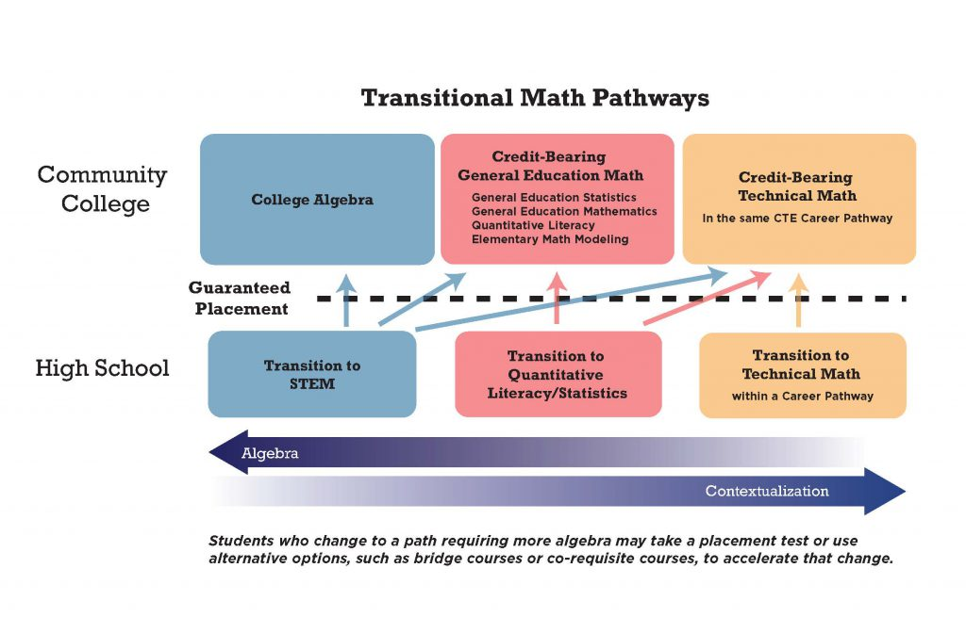
Transitional Math Pathways

Slide 8
Transitional Math Pathways
Each school will choose a pathway that most meets the needs of their students
The QL/Statistics pathway is the default pathway for a student who is undecided on his/her meta-major

Slide 9
Standards according to the PWR Act Competencies and Policies
Students must earn a C or better in order to receive placement into the appropriate course at the community college level.
At least 25% of the overall grade must come from problem or project-based learning tasks
A single assessment may not be more than 50% of the final grade in the course.
No more that 25% of the course grade can come from formative assignments such as homework.

Slide 10
Additional standards and grading policies according to Lake Land College
Percentages for the categories should total to 100%.
Formatives (includes homework): 10 – 25%
Projects: 25 – 40%
Unit tests: 30 – 50%
Final exams (one per semester): 15 – 25%
No more than 2 unit test retakes may be granted to a student. Final exams are not subject to retakes.
Projects and formative assignments can be redone without limit.
Unit test retakes must require student evidence of remediation on the content prior to taking a different version of the original unit test.

Slide 11
Documentation Required for Portability Approval
MOU
Syllabus
Content Competencies
Please watch the ALMY education course on how to accurately fill these documents
  https://courses.almyeducation.com/offers/2zJDtE9t
  The access code was sent through e-mail Summer 2020

Slide 12
Materials for QL/STATS
State developed materials: The syllabus and content competencies are already filled in-MAKE SURE YOU LOOK OVER BEFORE ADOPTING
  These documents are located on the Almy Education course
Publisher materials
  The documents for a course using the textbook MATH LIT is also on the Almy Education course
Design your own course: You design units that meet all the competencies in a contextualized, integrated way
  QL/STATS competency rubric:
    http://www.iltransitionalmath.org/curriculum/documents-by-pathway/

Slide 13
QL/STATS Resources
http://www.iltransitionalmath.org/quantitative-literacy-statistics-resources/ This is password protected: e-mail us for password
http://www.iltransitionalmath.org/isu-resource-real-numbers-curriculum/ This is password protected: e-mail us for password
http://www.iltransitionalmath.org/resources-from-il-partnerships/
We have completed high school documentation available upon request

Slide 14
Materials for STEM
Design your own course: You design units that meet all the competencies in a contextualized, integrated way
  STEM competency rubric:
    http://www.iltransitionalmath.org/curriculum/documents-by-pathway/
Publisher materials
  The content competencies for a course using OpenStax and Almy Education is also on the Almy Education course

Slide 15
STEM Resources
http://www.iltransitionalmath.org/resources-from-il-partnerships/
http://www.iltransitionalmath.org/isu-resource-real-numbers-curriculum/ This is password protected: e-mail us for password
We have completed high school documentation available upon request

Slide 16
Transcripting
High schools should only add a portability code to a student’s transcript if a course has been approved portable and the student has earned a C or better in it. In the notes section of the transcript, include the following:
  Portability code
  End date of course
  Course grade

Slide 17
Contacts
Bambi Jones: bjones@lakelandcollege.edu
Sarah Harley: sharley@lakelandcollege.edu

