Slide 1
Understanding Guided Pathways
Presentation for IACCAI
October 12, 2018
Darci Cather
Dean of Guided Pathways for Student Success
Lake Land College

Slide 2
Objectives
History of Guided Pathways
Discussion of Problems
Cafeteria Model vs. Guided Pathways Model
Guided Pathways Essential Components and Practices

Slide 3



Background Information
Based on work through the Gates Foundation Completion by Design and Lumina Foundation
Groundbreaking research from Bailey, Jaggars, and Jenkins’ Redesigning America’s Community Colleges
AACC’s Guided Pathways Project
Designed to contribute to the country’s Completion Goals

Slide 4
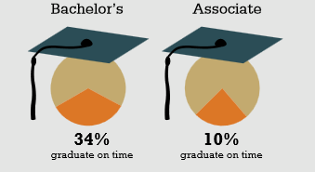
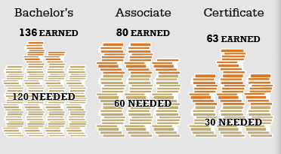
What’s the Problem?

Slide 5
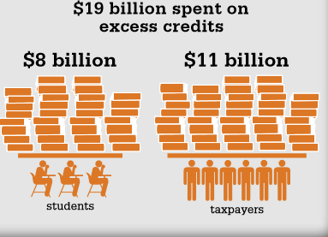
As a Result…

Slide 6
Why are Students taking So Long to Graduate?
Students make poor choices and take credits that don’t count toward declared degree
Courses are not available when students need them, and thus they take other courses to maintain financial aid eligibility
Students withdraw or fail courses, having to retake them
Broken transfer policies undermine students’ success and progress

Slide 7
Why Guided Pathways?
60%
20%
30%
30%
20%
Vulnerable
May Fail
Need
Guidance
Great
Gone
100%

Slide 8
What are Guided Pathways?
Guided Pathways spring from the idea that if students are able to determine their interests and choose the right degree earlier on, then they will be more likely to complete their degrees in a timely fashion.
Currently most colleges operate on a “cafeteria model” in which students are presented with an abundance of classes, programs, and support services which are typically disconnected.
Notes:
Incoming students are given support to explore careers, choose a program of study, and develop an academic plan based on program maps created by faculty and advisors. This approach simplifies student decision-making and allows colleges to provide predictable schedules and frequent feedback so students can complete programs more efficiently.
Students then serve themselves, choosing what to take or when to seek help. As a result many struggle to make these decisions, not know what to take or when to seek assistance. Many end up dropping out of college.

Slide 9
What are Guided Pathways?
Redesign the college’s offerings into highly structured, well-designed program maps that align with their career choices and educational goals.
Notes:
Incoming students are given support to explore careers, choose a program of study, and develop an academic plan based on program maps created by faculty and advisors. This approach simplifies student decision-making and allows colleges to provide predictable schedules and frequent feedback so students can complete programs more efficiently.

Slide 10
What’s the Difference?
Cafeteria Style
Many courses, programs, and supports
Students navigate resources on their own
Focus is on maximizing student access
Guided Pathways
Clearly structured
Educationally coherent
Created by faculty and student services professionals
Active instruction and aligned student support
Access with success

Slide 11
Essential Components of
Guided Pathways
Students will choose coherent, whole programs instead of individual, random classes
Students will make informed, deliberate, and simpler choices
Students will not take credits outside of their declared major, as all credits are designed to count toward declared degrees

Slide 12
Essential Components of
Guided Pathways
Students will take “milestone” courses to ensure proper progression to graduation
Default pathways will be designed so that no student will remain undeclared
End-to-end design – pathways or program maps will be designed by faculty and advisors with end goals in mind

Slide 13
Do We Really Need to Change?
Colleges are setup to encourage low cost enrollment.
Colleges provide many low cost courses which allow students to explore.
Students take courses that do not count toward their degree, as it appears complicated and complex.
Students are left with many questions, as they often do not receive enough help or even know where to find help.
Notes:
Number of how many credits students typically finish with
Number of students who return vs. those who drop out

Slide 14
THE
GUIDED PATHWAYS MODEL
WHAT DOES IT MEAN FOR US?

Slide 15
Essential Practices for
Guided Pathways
1. Clarify Paths to Student End Goals:
  Simplify students’ choices by providing default program maps;
  Develop transfer pathways by aligning pathway courses with expected learning outcomes with transfer institutions;
  Align high school pathways including dual credit courses and student learning outcomes, with college certificates and/or degree programs.

Slide 16
Essential Practices for
Guided Pathways
2. Help Students Choose and Enter a Pathway:
  Bridge K-12 to higher education through early remediation in the final year of high school;
  Redesign traditional remediation as on “on-ramp” to a program of study;
  Provide accelerated remediation to help unprepared students succeed in college-level courses.

Slide 17

Essential Practices for
Guided Pathways
3. Help Students Stay on Pathway:
  Support students through a strong advising process;
  Embed academic and non-academic supports throughout the students’ program to improve student learning and persistence.

Slide 18
Essential Practices for
Guided Pathways
4. Ensure that Students are Learning:
  Establish program-level learning outcomes aligned with the objectives for successful employment and further education;
  Integrate group projects, internships, and other applied learning experiences to enhance instruction and student success;
  Ensure incorporation of effective teaching practices that promotes student engagement.

Slide 19
Does GPS Really Work?
Florida State University: Graduation rates have increased 10% to 74% since implementing GPS model. (10 year period)
Tennessee Technology Centers: More than 75% of students are graduating on time.
Georgia State: Degree maps and intrusive advising have increased graduation rates by 20% over a 10 year time period.
Austin Community College: Generated an 11% increase in persistence since implementing degree maps.

Slide 20
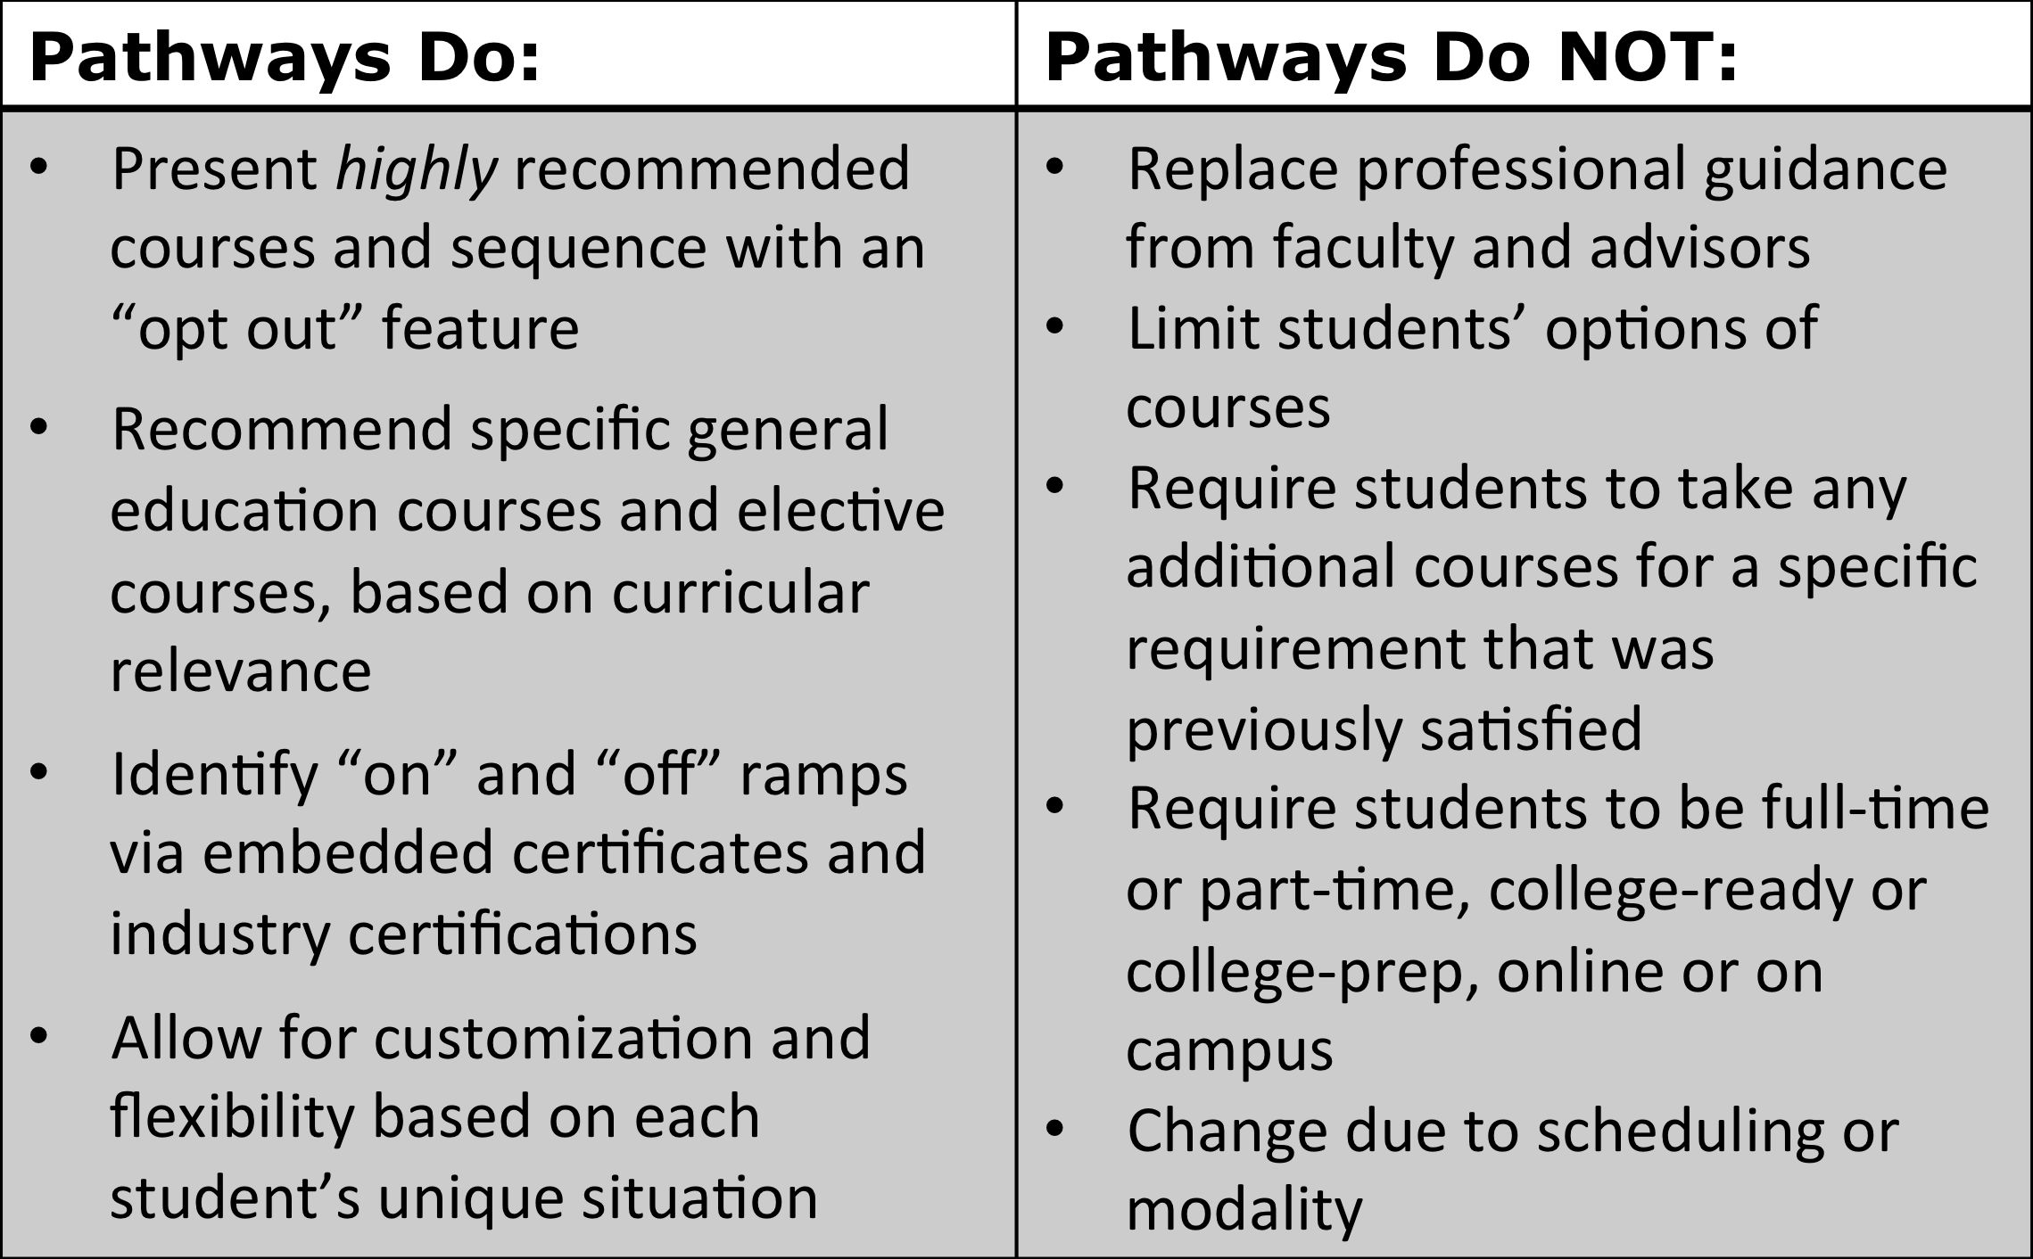
Guided Pathways Features
*Source: “Our Journey through the Pathways.” North Arkansas College

Slide 21
Summary
Guided Pathways are:
Designed to ensure students take only necessary courses that count toward their degree
Different from the “self-service” cafeteria model
Designed to clarify paths to student end goals
Help students choose and enter a pathway
Help students stay on path
Ensure that students are learning
College-Wide initiative led by faculty and staff

Slide 22
References
Bailey, Thomas R., Shanna Smith Jaggars, and Davis Jenkins. Redesigning America's Community Colleges: A Clearer Path to Student Success. Cambridge, Massachusetts: Harvard University Press, 2015.
Bailey, Thomas R., Shanna Smith Jaggars, and Davis Jenkins. “What We Know about Guided Pathways.” CCRC. April 2015. Accessed 17 June 2018.
Bowman, Margaret. “Integrating Academies and Student Support Services to Enable SPC Students to Start Smart and Finish Strong.” National Higher Education Benchmarking Conference. 4 May 2016.
Complete College America. “Guided Pathways to Success: Boosting College Completion.” December 2012.
Johnstone, Rob. “Guided Pathways Demystified I.” National Center for Inquiry & Improvement. Nov. 2015. Accessed 17 June 2018.
Johnstone, Rob. “Guided Pathways Demystified II.” National Center for Inquiry & Improvement. Sept. 2017. Accessed 17 June 2018.

Slide 23


