Slide 1
Dual 2 Orientation

Slide 2
Introduction
Tessa Wiles
Director of Dual Credit and
Honors Experience

Slide 3
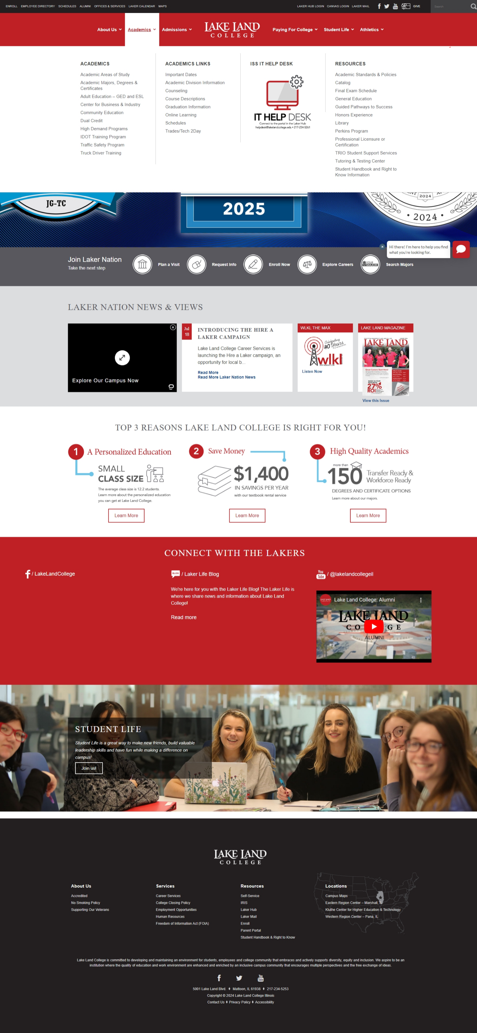
To get started
TALK WITH YOUR HIGH SCHOOL COUNSELOR
Create Laker Profile

Slide 4
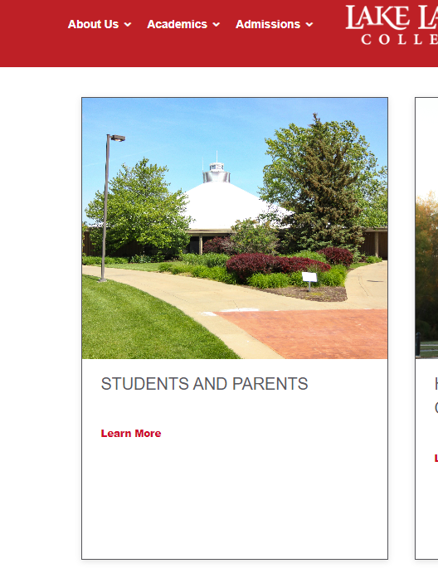
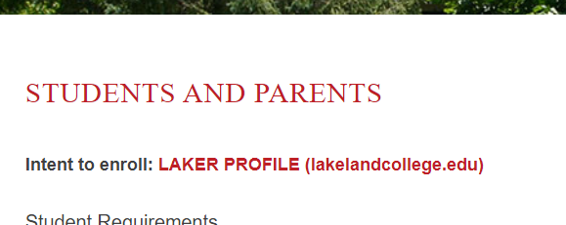
Laker Profile Cont.

Slide 5
Application
After completing the profile it will show a notification to complete the “intent” – this is being renamed “application”, but is the same process.
*If you have taken a dual credit class before or completed one already (as long as the graduation date is correct) you will not need to complete another one.

Slide 6
Requirements
  You must follow the Lake Land Academic Calendar – Where to find – Website!
  You must maintain a 2.0 GPA or you risk being dismissed
  Please communicate with your instructors if you will be absent, late, or other issues
  Your absences will be reported to the high school

Slide 7
Student Portal, Canvas, Virtual Machine
Laker HUB is the Student Portal
  Access student information: GPA, schedule, Canvas, Laker email
Canvas is Lake Land’s learning management software – online classroom
Virtual Machine is where you can access your Laker desktop from any computer – think of this as the cloud

Slide 8
Logging in
Two step verification
  Instructions sent via email, announcement on Canvas
  Students do not need to download app – can use text message instead
  iPhone updates clear the authenticator app – contact ISS or use text message verification

Slide 9
Canvas
Click this link: Canvas FAQs - Lake Land College
Practice and Guide Page – Does not count for a grade. Click this link:
https://lakeland.instructure.com/courses/1470971

Slide 10
Email and Office 365
Lake Land College uses Outlook and Office 365
Please note this is different from Google classroom
If you send an email or attachment to an LLC employee please make sure it is not in a locked document

Slide 11
Adding an attachment On Outlook for Desktop - Windows/Mac
Open a New Email
Click New Email in the Home tab.
Click “Attach File”
On the ribbon, go to the Message tab and select Attach File.
Choose Browse This PC (Windows) or Browse (Mac) to locate your file.
Navigate to the folder where your file is saved.
Click the file, then select Insert.
Verify the Attachment
You’ll see the file name appear under the subject line in your email.
Add your recipient, subject, and message, then click Send.

Slide 12
Adding an attachment On Outlook Web - Outlook.com or Office 365
Choose Browse this computer to upload from your device, or Browse cloud locations to attach from OneDrive.
Select and Upload
The file will appear below the subject line.
Add your recipient, subject, and message, then click Send.
Start a New Message
Click New Message in the top left.
Attach Your File
Click the paperclip icon at the bottom of the compose window.

Slide 13
Dropping or withdraw
Any decision to drop a class must be done with your high school counselor and dual credit. Deadlines for cost and how it appears on your transcript.
Please speak with your instructor before you considering dropping to discuss concerns
You only have a limited amount of time to drop. After it will become a withdraw which will leave a W on your transcript and can affect completion rate on financial aid

Slide 14
Technology for online or virtual
If you are all online you access your course in Canvas. Courses on Canvas may not be open until the first day, but some teachers might open them early.
If you are participating in any virtual options (zoom) please make sure you have a working connection, video camera, microphone, and quiet place. You will need to participate, mute and unmute yourself, and login to the zoom link which is in your Canvas page.
Remember you are on camera, and the teacher can see if you are talking or causing a distraction! If your classroom had the hyflex equipment the camera will follow movement.

Slide 15
Transcripts
After completing Dual Credit courses you will have a college transcript which you can transfer via Parchment

Slide 16
Things to remember
Communication with the Lake Land College instructor is very important. They can’t help you if you are not communicating.
You have access to college resources: library, tutoring, etc.
Grades are important and permanent.
The days you are allowed off from high school are not the same as permitted missed days in class. (I.e. college visit days, sports)
You are in a college class with college level expectations. Held to the LLC Code of Conduct. Plagiarizing or cheating of any kind will be handles according to LLC policies in collaboration with your high school principal.
We are all here to help you succeed.

Slide 17
Announcements
Laker Connect Benefits:
Students and Parents - Lake Land College

Slide 18
Shameless plug for Honors Experience
Click Link: Honors Experience - Lake Land College

Slide 19
Thank you!

